Slide 1


App Portfolio Modernization
Hugo Melendez
Technical Solution Professional
Notes:
For some time now, the buzzword on everybody’s lips when it comes to innovation has been Digital Transformation.
Do a web search, and you will find a plethora of quotes and citations about the need to change how business is done today by thought leaders, CEOs and assorted business gurus.
The common thread that runs through all of these quotes is that Digital Transformation isn't just for Silicon Valley companies or young startups anymore.
It's a way of life for organizations looking to survive in the next decade.

Slide 2



Who Am I?

Slide 3
3 minute survey: https://aka.ms/buenosairesapps2018

Slide 4
Hands-on labs: https://aka.ms/DevDaysLatam

Slide 5
Agenda
App Modernization
Azure Containers
Cloud DevOps
Serverless
Cognitive Services

Slide 6
App Modernization

Slide 7
Applications fuel digital transformation
Engage your customers
Transform your products
Apps
Digital Transformation
Enable your employees
Optimize your operations
Notes:
App Innovation fuels digital transformation
Digital transformation is top-of-mind for every business, regardless of industry, shape, and size.
Whether it’s to engage with customers in new and innovative ways, to transform and differentiate their products, to create efficiencies in operations, or to empower a new generation of millennials in the workforce.
Businesses are embracing new technologies at a pace never seen before so that they can remain relevant and stay ahead of their competition.
And in doing so, organizations of all sizes across industries are realigning their business around digital experiences, because they realize that the majority of interactions with customers, employees, and partners going forward will happen through apps and other digital channels.
And as the business world moves into the digital space—to meet the next generation of customers, employees, and partners; to create new efficiencies; and to compete globally—apps, and specifically innovation through apps, is central to their strategy.
We call this app innovation, and we see it at the core of every digital transformation journey.

Slide 8
Value to Optimize and Modernize
Agility
Time to market
Total cost of ownership
IT simplification
Continuous delivery
Containers
Scalability and HA
Insights and Analytics
Infrastructure Cost
Ongoing Maintenance
Standardization
Simplification
Notes:
S

Slide 9
Widening digital divide between Business and IT
Business needs
IT challenges
Rapid innovation to transform products
Connect with customer and empower employees
Close the gap from data to decision
72% 1 budget assigned to keep-the-lights-on functions
Demand for mobile apps >5x the capacity of IT
Only half decision makers could get help from technologists with their analysis needs 2
Notes:
With the accelerating pace of change around us, every business needs to innovate & change faster than ever before
Old infrastructure and traditional ways of building apps are becoming growth inhibitors for an enterprise
Business need rapid innovation – to rollout out new business models, optimize business processes, respond to regulations
72% of IT budget is dedicated to keep-the-lights-on functions which doesn’t leave whole lot for new projects
Businesses need their employees to be productive on the go. And everyone wants to be able to connect to their LoB systems, regardless of whether they are old are new, through mobile devices
Demand for mobile apps is 5x the capacity of IT
Business leaders want their employees to make decisions faster which requires friction free access to data, reporting and analysis.
For many traditional IT departments, this creates an endless churn of building reports – taking precious resources away from new development initiatives and still not being able to meet the reporting needs of business
These are just some examples illustrating the widening digital divide between Business and IT
And today we’re going to show you how you can address these challenges & transform your internal business apps leveraging the strengths of IT and business (power users)
Shadow IT. Security concerns
Source 1. Data source: Forrester IT Survey, 2013
Forrester Research survey of IT leaders at more than 3,700 companies, respondents estimated that they spend an average 72% of the money in their budgets on such keep-the-lights-on functions as replacing or expanding capacity and supporting ongoing operations and maintenance, while only 28% of the money goes toward new projects.
Source 2: Forrester Predicts Investment In Artificial Intelligence Will Grow 300% in 2017. Forrester Research, Inc. November 1, 2016. (Source)
While in 2015 it found that only 51% of data and analytics decision-makers said that they were able to easily obtain data and analyze it without the help of technologist, Forrester expects this figure to rise to around 66% in 2017
===================================================================
Data source: Enterprise Application Trends. Gartner, 2016
By the end of 2017, market demand for mobile app development services will grow at least five times faster than internal IT organizations' capacity to deliver them
http://www.gartner.com/newsroom/id/3076817

Slide 10
Challenges with current applications
Aging infrastructure
Lack of agility
Legacy applications
Operational costs, lower efficiency and reliability
Capital expenditure requirements
Security, audit, and regulatory compliance
Long time to provision resources and deploy
Hard to do rapid dev/test and prototyping
Inflexible, monolithic & highly coupled app design
Highly IT dependent
Hard to compose/integrate across environments
Needs of mobile workforce and data driven innovation
80%
28%
Time spent on administrative tasks
40%
Global IT budgets dedicated to maintenance
Increase of data breach incidents in 2016
Notes:
Now this is a picture that all of us can relate to. We typically have to work with lots of LoB apps. Many enterprises have more than 1,000 LoB systems – You might have a system for budgeting, orders, invoices, approvals and so on. In fact, many companies have multiple systems serving somewhat similar function, say, Approvals. And employees really have to jump from one system to another to get work done or request IT to create mash-up apps that pull data from different systems and create workflows to capture the details as a document moves from one employee to another or from one dept to another.
It is not surprising, almost all employees now expect to access LoB systems from mobile devices which is fueling huge demand for mobile apps in an enterprise. And if they cannot access the data easily, it impacts their productivity. With the changing needs of business, they also request lots of changes and need them sooner than latter.
But lot of these systems are hard to change.
Some of the LoB systems were built10-20 years ago and it goes without saying it is not easy or practical to replace them. They are going to be there for a long time.
Next, there is a wide variety of LoB apps. You still have many companies running their core business processes using Mainframes. For some apps, you might have created custom built apps, or have an ISV solution customized per your organization needs.
Next, you might be hosting some apps in cloud or on-premises.
This makes it hard for IT to maintain and innovate on these apps matching the speed of business. Here are some implications of the state most large enterprises find themselves in:
1st …. 80% of IT budget is spent on maintenance which means there is only 20% left to do something new. You might be thinking about Digital transformation but lots of times will find IT not having sufficient budget to support your request. It is not that IT doesn’t want to move fast but are constrained by budget and resources.
2nd every business leader today wants their organization be more agile. They want their employees should be able to respond faster to end customers, if there is a change you should be able land it fast in the marketplace. This requires your employees to be highly productive but about 28% of their time is spent on administrative tasks such as copying data from one system to another, approving in one system and then into another and so on, or manually driving a business process, or spending time on finding data which might be hiding somewhere in these systems. This creates a huge productivity drag and impacts the agility of your whole enterprise.
3rd Security is top of mind for everyone. Not only you need it for compliance reasons but it is also about customers’ trust. Unfortunately, the number of When customers given their data to you they expect you to keep it secure and that is why data breaches are so costly as they impact your ability to attract and retain customers.
=============================================================================
Data sources:
Cost: http://www.gartner.com/newsroom/id/497088
2) Agility: https://acrobat.adobe.com/content/dam/doc-cloud/en/pdfs/idc-adobe-document-disconnect-whitepaper-global-ue-final.pdf
3) Security: http://www.idtheftcenter.org/2016databreaches.html
=====================================================================================================
Productivity & Agility
Employees spend so much of time searching and gather data vs getting contextual info/data automatically.
It takes far too long to respond to changing business processes or new business requirements
Agility: For achieving agility, there should be a rolling plan in addition to the mid-term or long-term strategic planning document. Need for agility arises due to changes in underlying assumptions. If these changes are captured in the rolling plan, flexibility can be achieved. Every CIO may ask self: Is IT responsive and proactive enough to find answers and solutions in case of emerging chances? Does IT have a platform which is scalable, secure, resilient and well interconnected? IT is now the rate limiter for change, the IT infrastructure that was implemented to deliver business automation in the 20th Century, which it did quite well through standardization, now impedes business agility in the 21st Century; a movement that recognizes increasingly dynamic business environments and the need for operational responsiveness is on the way. Organizations need to adaptive IT infrastructure for business sustainability. This reflects that systems development, qualification, and deployment are complex tasks. The business aspiration to agility can often be leveraged to help align business and technology stakeholders around the case for application modernization and rationalization. Many businesses aspire to agility when they are burdened by brittle, tightly coupled systems constrained by rigid roadmaps and deployment schedules due to the underlying code debt, integration dependencies, and testing complexity. In the meantime, well-run technology organizations can demonstrate alignment by being responsive to tactical business opportunities to the degree possible while remaining focused on developing, communicating, and executing a longer-term strategy to enable and maintain true enterprise agility.
http://futureofcio.blogspot.com/2013/10/how-to-define-it-agility.html
Cost
Legacy applications cost a lot to maintain and more resources to innovate on.
They are result in high cost for the business - to run & operate various business processes.
Security
Having different applications having their own user-id password, creates more points of failure
Lots of data in today’s enterprise in not encrypted

Slide 11



We can helpapplications
Deliver a modern experience on legacy systems
From zero to a full-fledged ecommerce marketplace
Customer Engagement Innovator with rich mobile app
Challenge: Modern experience on top of their LoB apps, 400 systems of record, some are 30 years old
Challenge: we will have to handle millions of customers. That requires a top-class e-commerce system built on a flexible, open cloud platform
Challenge: pain points engaging customers via mobile: add themselves to a wait list, get alerts, pay via mobile phone, and earn points in reward system. The process needs to be streamlined.
Success:
70% infrastructure consolidation
Success:
12 month to build vs 2 years.
Success:
Winner of 2016 Restaurant Breakthrough Award
Notes:
1) Metlife:
Built an application, using containers, that "wrap" the decades worth of legacy systems
The new application was able to tap into these systems of record to access the data and serve it up to both customers and agents alike in a single online experience, while gaining operational scale through cloud infrastructure.
The result:
70% consolidation on infrastructure by moving to Cloud.
IT Agility. Apps built using containers access to legacy systems, serving agents and customers via one app.
Easy deployment anywhere around the globe.
2 https://enterprise.microsoft.com/en-us/customer-story/industries/retail-and-consumer-goods/jet-com/
To be one of the best e-commerce destinations in the US, we will have to handle millions of customers. That requires a top-class e-commerce system built on a flexible, open cloud platform. That is exactly what we got with Azure. From microservices to App
Being able to leverage so many off-the-shelf services and tools from Azure enabled us to go from zero to a full-fledged e-commerce marketplace in just 12 months
Benefits
Working with Microsoft Azure cloud services has provided Jet with a level of flexibility and scalability that has been critical to its aggressive development schedule.
Moving from code to production in minutes.
By using App Service for its consumer front end, Jet has been able to dramatically streamline its development process, so that it can build, deploy, and scale consumer-grade web apps more rapidly. As Hanrahan says, “We’ve been able to get our critical code through our CI/CD process in a couple of minutes using App Service.”
Scaling automatically to meet customer demand
As with any popular e-retailing site, Jet requires extremely rapid and flexible scaling based on ever-changing customer traffic. To streamline this process, Jet was able to set up auto-scaling on both PaaS servers and App Service to scale its servers based on load or schedule. “Because both PaaS and App Service scale automatically for us, we are able to throw as many machines as we need at the front end, when we need them,” says Hanrahan.
Accommodating rapidly growing storage requirements
3) [Note: if you used the Outback Steakhouse demo example, simply reference and remind the customer, while going into more details about their story).
Outback Steakhouse, a restaurant chain, transforms their customer experiences and builds customer loyalty with a five-star apps - powered by Microsoft mobile DevOps technology and Azure cloud services.
Bloomin’ Brands, Inc. is one of the world’s largest casual dining companies and operates over 1,500 restaurants, including Outback Steakhouse.
By pairing mobile DevOps and the cloud, the development team is pioneering the future of casual dining experiences, making it fast and easy for Outback Steakhouse customers to get seated and pay for their meals. Customers are able to view nearby locations, add themselves to waitlists, receive push notifications when tables are ready, and pay at their tables— all from the Outback Steakhouse app.
To create this five-star app experience, the team replaced HTML5 apps with fully redesigned Xamarin apps, and started development with Xamarin Client
Services teams’ guidance and technical expertise. In addition to customer-facing mobile capabilities, they also use Microsoft Azure to sync seating assignments and customer orders. Automated testing across devices with the Xamarin Test Cloud ensures they catch any issues early in the development cycle, before they affect customers.
They released the new experience in mid-2016, and immediately received amazing reviews from customers across the country. Based on customer reactions and overwhelmingly positive response, Bloomin’ Brands has delivered a similar customer-facing mobile app for its Carrabba’s Italian Grille chain, now rolled out nationwide. Going forward, they’ll continue to expand to other brands.
Read more about their story here (including video): xamarin.com/customers/hospitality#outback
===============================================================================================
1) METLIFE
https://www.docker.com/customers/metlife-transforms-customer-experience-legacy-and-microservices-mashup
Talking points:
Application built with modern and open source components to "wrap" the decades worth of legacy systems
The portability efficiency of Docker built applications allowed MetLife to achieve a 70% consolidation on infrastructure while gaining operational scale through cloud infrastructure.
Once modernized, the new application was able to tap into these systems of record to access the data and serve it up to both customers and agents alike in a single online experience.
The application can be easily deployed anywhere around the world on-premises or in the cloud - consistently, efficiently and securely.
2) ALASKA airline
https://azure.microsoft.com/en-us/resources/videos/alaska-airlines-visual-studio-team-services-xamarin/
TransAlta
https://customers.microsoft.com/en-us/story/multi-national-energy-company-uses-powerapps-to-create-a-decision-validation-tool
Talking points:
By using Microsoft PowerApps, TransAlta built an internal resource planning and decision validation application tailored to its unique business needs. TransAlta harnessed the application to enhance resourcing decisions and maximize the ROI. Within the first two weeks of deployment, TransAlta recovered the cost of building and implementing PowerApps—with the net benefit continuing to pay off.

Slide 12
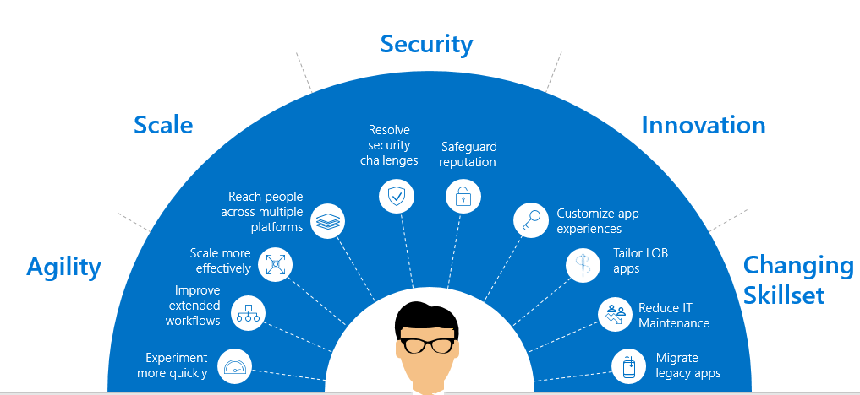
Reasons to Modernize Applications
Cost
Agility
Security
Reduce costs by up to 90% by digitizing businesses processes
Agile firms grow revenue up to 37% faster
94% on-prem. customers experienced additional security benefits
Notes:
By modernizing the infrastructure that powers your applications, you can drive significant cost efficiencies and save on IT maintenance budget.
Not only that, there is a McKinsey study which says “by digitizing information-intensive processes, costs can be cut by up to 90 percent and turnaround times improved by several orders of magnitude”
The second is from a MIT study that found agile firms increase revenues 37 percent faster than non-agile companies; the same businesses also generate 30 percent higher profits than their non-agile counterparts.
The third one is my favorite as when I talk to customers about cloud they typically ask whether it will make their data more secure? And we had comScore run a study for us and it found 94% on-premises customers experienced additional security benefits. Which is not surprising because once you move your servers say SQL server to the cloud, we will keep them up-to-date and monitor the security.
=====================================================================
1) Cost: Accelerating the digitization of business processes. McKinsey, May, 2014.
http://www.mckinsey.com/business-functions/digital-mckinsey/our-insights/accelerating-the-digitization-of-business-processes
2) Agility:
A 2009 study at MIT found that agile firms increase revenues 37 percent faster than non-agile companies; the same businesses also generate 30 percent higher profits than their non-agile counterparts
“IT Portfolio Management and IT Savvy—Rethinking IT Investments as a Portfolio,” MIT Sloan School of Management, Center for Information Systems Research, Summer Session, Peter Weill, June 14, 2007. Research was conducted by MIT via the SeeIT/CISR survey of firms, of which were listed on U.S. stock exchanges. The work was financed by the National Science Foundation grant number IIS- 0085725. Copyright © Massachusetts Institute of Technology, 2007; created by MIT’s Sloan Center for Systems Research (CISR). http://www.ca.com/content/dam/ca/us/files/white-paper/a-cios-guide-five-steps-to-business-agility.pdf
The third one is really interesting. This comes from a study we had comScore conduct for us. 94% on-premises customers experienced additional security benefits. Which is not surprising because once you move your servers say SQL server to the cloud, we will keep them up-to-date and monitor the security.
===================================================================================================
Security.
Source: Barriers to Cloud Adoption study, ComScore, Sept 2013
Azure can help reduce the cost, complexity, and risk associated with security and compliance in the cloud. A survey funded by Microsoft and performed by ComScore demonstrates that while many organizations have initial concerns about moving to the cloud, a majority of cloud adopters achieve significant security benefits:
CLICK. Before embarking on cloud computing, 60% cited concerns around data security as a barrier to adoption, and 45% were concerned that the cloud would result in a lack of data control
CLICK. However, after moving to the cloud, a majority of cloud adopters achieve significant security benefits. 94% experienced security benefits they didn’t previously have on-premises and 62% said privacy protection increased as a result of moving to the field.
Few individual customer organizations can replicate the technology and operational processes that Microsoft uses to help safeguard its enterprise cloud services and comply with a wide range of international standards.
When companies use Microsoft Azure, they benefit from Microsoft’s scale and experience running highly secure and compliant online services around the globe. Microsoft’s expertise becomes the customer’s expertise.

Slide 13
Cloud Maturity Model
Existing apps
on-prem
Lift and Shift
Cloud optimized
App modernized
Lift & Shift
Minimal code-changes
Architected for the cloud
modernized/refactor/rewrite
Notes:
Using an existing .NET application

Slide 14
The Journey to the cloud
Migrate
Application Modernization
SaaS
Rehost
Refactor
Rearchitect
Rebuild
Replace
On-Premises
Infrastructure Platform
IaaS
Infrastructure Platform
“lift & shift”
Containers
Managed Container Platform
PaaS/Serverless
Application Platform
Notes:
Source: Gartner: “Developing a Public Cloud IaaS Adoption and Migration Framework” published March 2017
Rehosting: Rehosting is also referred to as a "lift-and-shift" migration. In essence, the application is moved into the IaaS environment of a cloud provider while avoiding as many modifications to the system as possible. In this case, you would not be taking advantage of cloud technology such as autoscaling, for example.
When to consider:
Ideal when your goal is to improve operational efficiencies, and free up data center space
Maintenance apps for which the hardware is not worth additional investment
Compute-intensive applications that are built for parallelism but don't require high-performance interprocess communications (IPC) and have independent datasets, and applications for which load balancing already increases scalability and availability.
Benefits
Drives higher ROI (435% from migration to IaaS). Try our TCO Calculator.
No need to manage data centers
Enjoy flexible and scalable infrastructure
Core technologies: VM, VM Scale sets
Refactor: Refactoring an application involves some change to the application design, but not wholesale changes to the application code. The application takes advantage of IaaS and potentially PaaS capabilities from the provider while maintaining code strategic to the application's use case.
Customers typically have a large portfolio on custom developed on-premise applications (.Net and OSS e.g. Java).
They are concerned about cost efficiency, security, and ongoing management/evolution of these apps. They are interested in the cloud to address these concerns, but are worried about how they can get there in an efficient way that optimizes/modernizes the application and make it more portable as they journey to the cloud.
They are increasingly looking to containers as the vehicle to modernize and move their applications to the cloud without significantly re-architecting their solutions.
Benefits
Drive continuous innovation by leveraging built-in DevOps or using Containers.
Easily scale up or down to meet the changing needs of the business
Improved portability and density.
Existing programming models, languages and frameworks that can be easily used and extended.
Technologies used: Containers , Container Orchestrators (Docker Swarm, DC/OS- Mezoshphere, Kubernetes)
Rearchitect: Rearchitecting an application for cloud usage enables you to take advantage of technologies such as autoscaling and dynamic reconfiguration. This process will require developer resources to implement and can take significant time to implement
When to consider
When apps need a major revision to incorporate new capabilities or take advantage of the cloud-native capabilities.
Benefits
Deliver new capabilities and modernization through modified codebase and a monolithic to micro services architectural revision.
Reduce the volume of code needed to express a capability while still leveraging existing investments.
Agility and scale.
Core Technologies
PaaS (e.g. Azure App Service), Serverless (Azure Functions and Logic Apps), Microservices (Service Fabric )
Legacy Apps
Monolithic - Built as a single unit with few separate services or components. Any services which are used tend to be custom built for the App.
Tightly Coupled - Tend to have internal and external dependences that impact both reliability and development agility.
Long Delivery Cycle - Slow to test, deploy, and scale. Making iteration difficult.
IT Dependent - Dependent on long lead time bare metal provided by IT. With complicated patching and update process.
Internet Apps
Service Oriented - Build modularly using packaged middleware, common services, and SOA architectures.
Loosely Coupled - Technology like messaging stacks and queues used to disintermediate apps. Management and diagnostic tools integrated into Apps.
Agile Delivery - Dependency management and disintermediation allows software to be built incrementally. Shortening delivery times from years to months.
Virtualized - Software hosted on virtualized infrastructure that reduces IT dependencies, improves delivery time, and simplifies update process.
Cloud Apps
Cloud Based Service - Applications built using API’s, SaaS Services, and independently scaling Microservices. With custom code only needed for core business logic.
Distributed - Applications use cloud services and API’s, further disintermediating tiers. Often taking advantage of on demand services that are not instantiated when not in use.
DevOps - Continuous Integration, Continuous deployment, and Testing in Production used to shorten delivery and scale times from months to days or hours.
Platform Based - Applications written to PaaS or IaaS based cloud platforms. Reducing scale times to minutes or even seconds and simplifying the patching and deployment process.

Slide 15
Multiple ways to Modernize, You can start at any stage
Migrate
Modernize & Innovate
ReHost
ReFactor
ReArchitect
ReBuild
Approach
Redeploy the application as-is to cloud
Minimally alter to take better advantage of cloud
Materially alter/decompose application to services
New code written with cloud native approach
Description
Reduce Capex
Free up datacenter space,
Quick cloud ROI
Faster, shorter, updates
Code portability
Greater cloud efficiency (resources, speed, cost)
Hyperscale
Independently scale and deploy parts of app
Mix technology stacks
Accelerate Innovation
Reduce TCO
Faster Development
Drivers
IaaS (VMs)
Containers
PaaS
Containers
PaaS
Microservices Platform
PaaS
Serverless
Technologies
Reduction in TCO approx. 30% on Average
PaaS : 466% ROI, 80% time saved, 5.91 M ROI, 50% faster deployments
Container : 13X more releases, 10X Cost Reduction, 65% Faster developer onboarding, 62% better availability
What customers are seeing
Notes:
Gartner IT Glossary.
Decision Point for Choosing a Cloud Application Migration Strategy, Gartner. Published: 29 March 2016
Source: “The Total Economic Impact Of Microsoft Azure PaaS,” a commissioned study conducted by Forrester Consulting, June 2016
Container ROI: State of App Development Survey: Q1 2016, Cornell University case study

Slide 16
Cloud Migration Strategies
Rehost
(lift & shift)
Refactor
Rearchitect
Rebuild
Description
Redeploy as-is to cloud
Minimally alter to take better advantage of cloud
Materially alter/decompose application to services
New code written with cloud native approach
Drivers
Reduce Capex
Free up datacenter space
Quick cloud ROI
Faster, shorter, updates
Code portability
Greater cloud efficiency (resources, speed, cost)
App scale and agility
Easier adoption of new cloud capabilities
Mix technology stacks
Accelerate innovation
Build apps faster
Reduce operational cost
Technologies
IaaS
Containers
PaaS
PaaS
Serverless
Microservices
Notes:
Gartner: Developing a Public Cloud IaaS Adoption and Migration Framework, published March 2017.

Slide 17

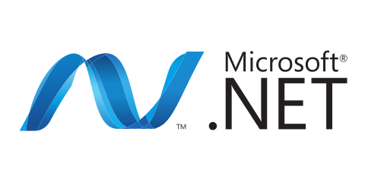
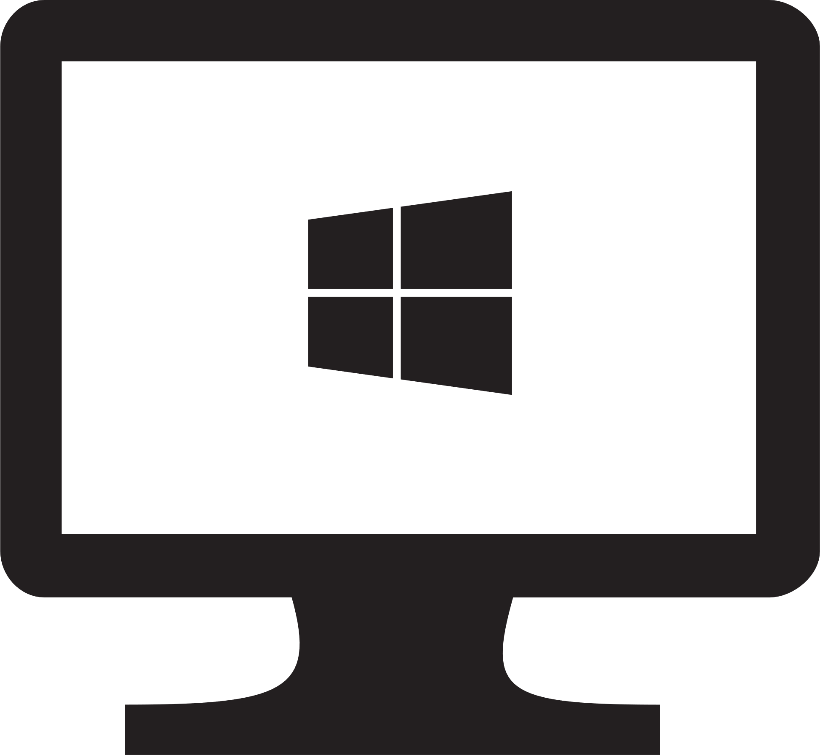




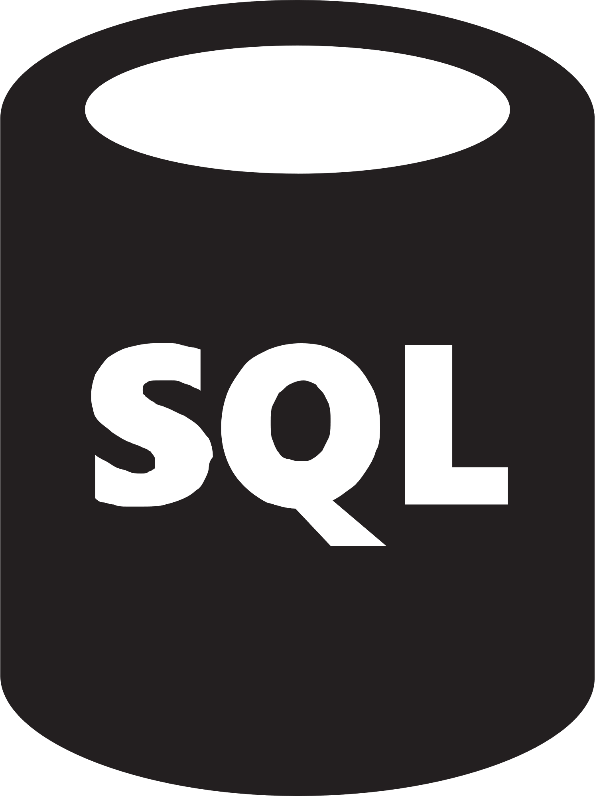
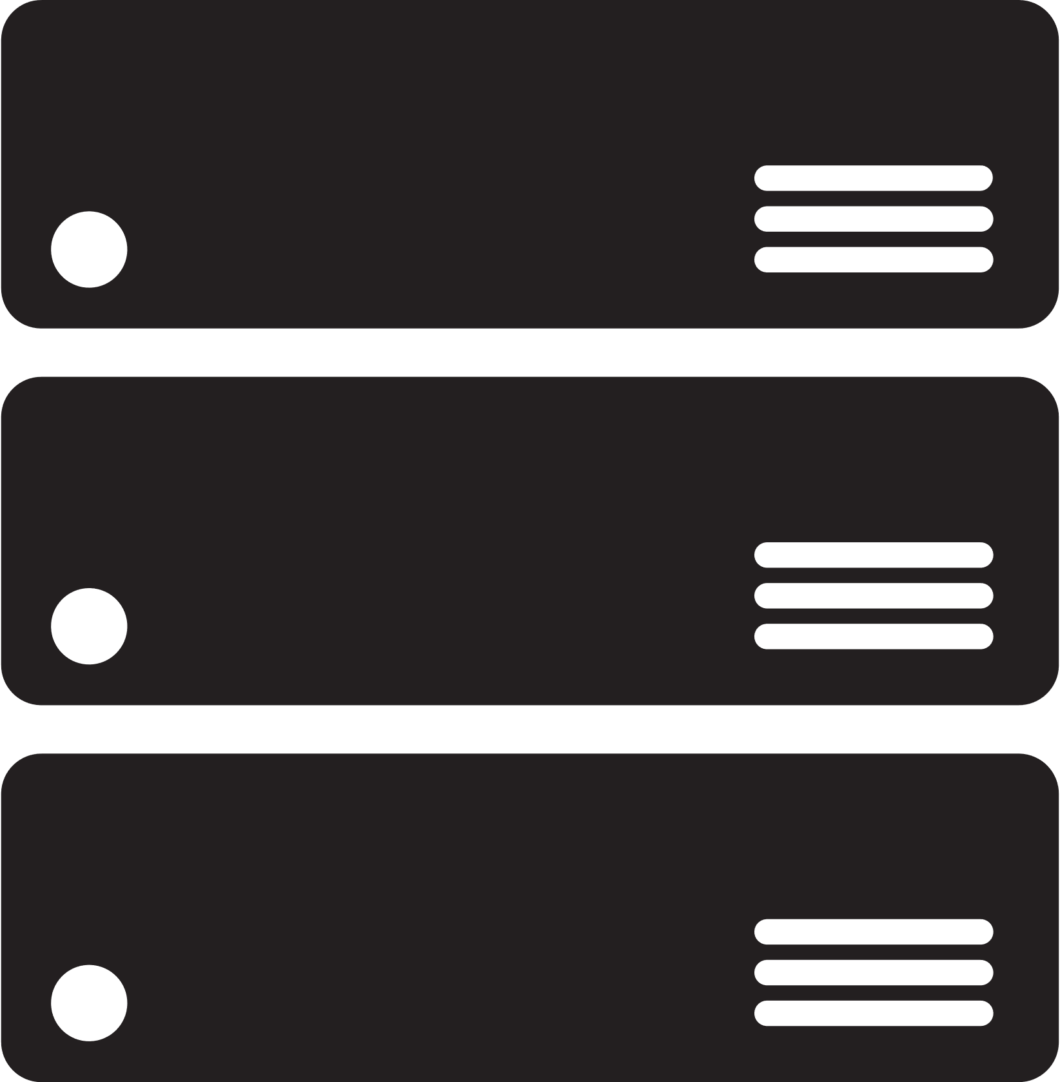
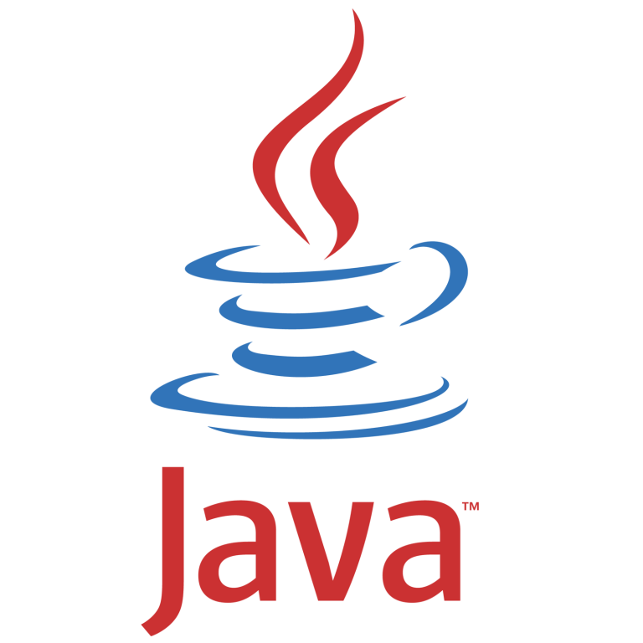
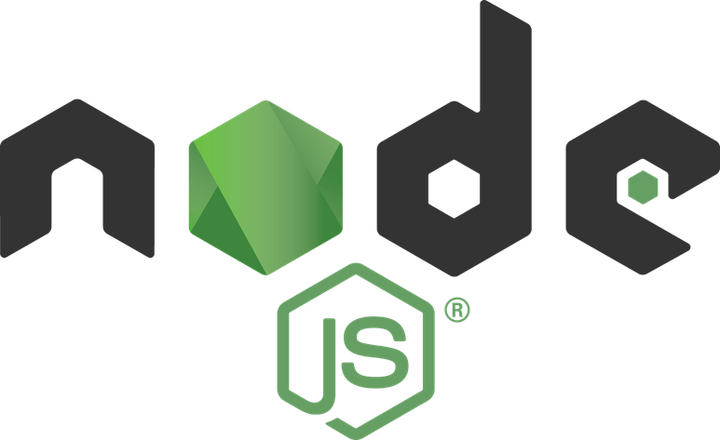



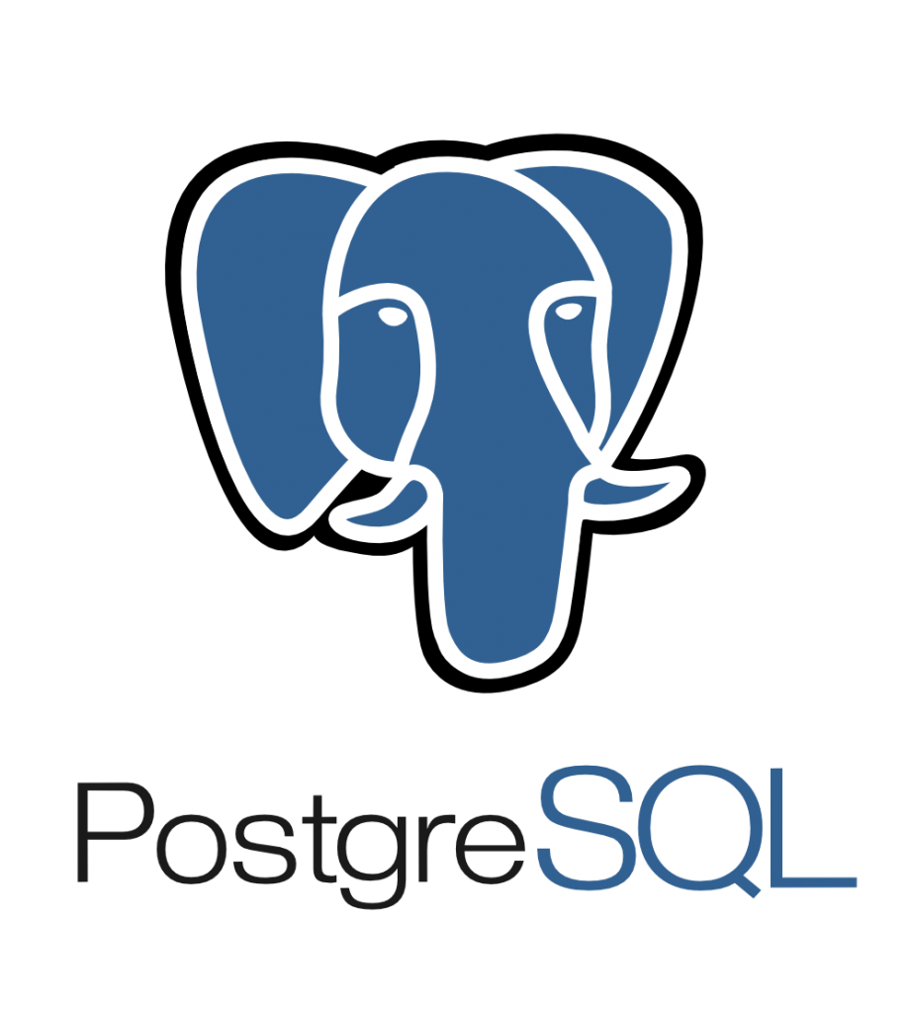
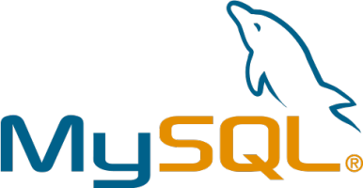


Migration strategies: Rehost application (i.e., lift & shift)
Sample illustration
On-premises
Azure
What is it?
Redeploy an existing application to a cloud platform without modifying its code. The application is migrated “as is”, which provides baseline cloud benefits without the risk or costs of making code changes.
When to use
Need to quickly move applications from on-premises to the cloud (e.g., datacenter contract expiry)
When the application is needed, but evolving its capabilities isn’t a business priority
For applications which are architected to leverage Azure IaaS scalability
Specific application or database requirements which can only be met by Azure VMs
Example
Move a line of business application to Azure VMs
Application tier
Application tier
Rehost
(lift and shift)
Azure IaaS VMs
Data tier
Data tier
Refactor
Azure Site Recovery
SQL Server
(on Windows Server)
Azure SQL Database Managed Instance
Rearchitect
Application tier
Application tier
Azure IaaS VMs
Rebuild
Data tier
Azure Database Migration Service
Data tier
Azure Database for PostgreSQL/MySQL
Notes:
Azure services
Compute: VM, VM Scale Sets

Slide 18


Migration strategies: Refactor application
What is it?
Minimally alter application code or configuration changes necessary to optimize the application for Azure PaaS and take better advantage of cloud.
When to use
Leveraging an existing codebase and development skills is paramount
Code portability is important
Application can be easily repackaged to run on Azure
Application needs to be more scalable and can be deployed faster
Looking to drive business agility with continuous innovation (DevOps)
Example
Refactor your existing app to Azure App Service or Azure Container Services (AKS), refactor your SQL Server to Azure SQL Database Managed Instance.
Sample illustration
Rehost
(lift and shift)
On-premises
Azure
Application tier
Application tier
Refactor
Web application
Azure App Service
Data tier
Data tier
Rearchitect
Azure SQL Database Managed Instance
SQL Server
(on Windows Server)
Rebuild
Notes:
Guideline:
If you make minimal changes, App Service is a good destination for .NET apps.
Azure services
Compute: App Service, Azure Container Service (AKS), Service Fabric
Data: Azure SQL Database Managed Instance, Azure Database Service for PostgreSQL, Azure Database Service for MySQL and Azure Cosmos DB
Land DevOps and Docker

Slide 19
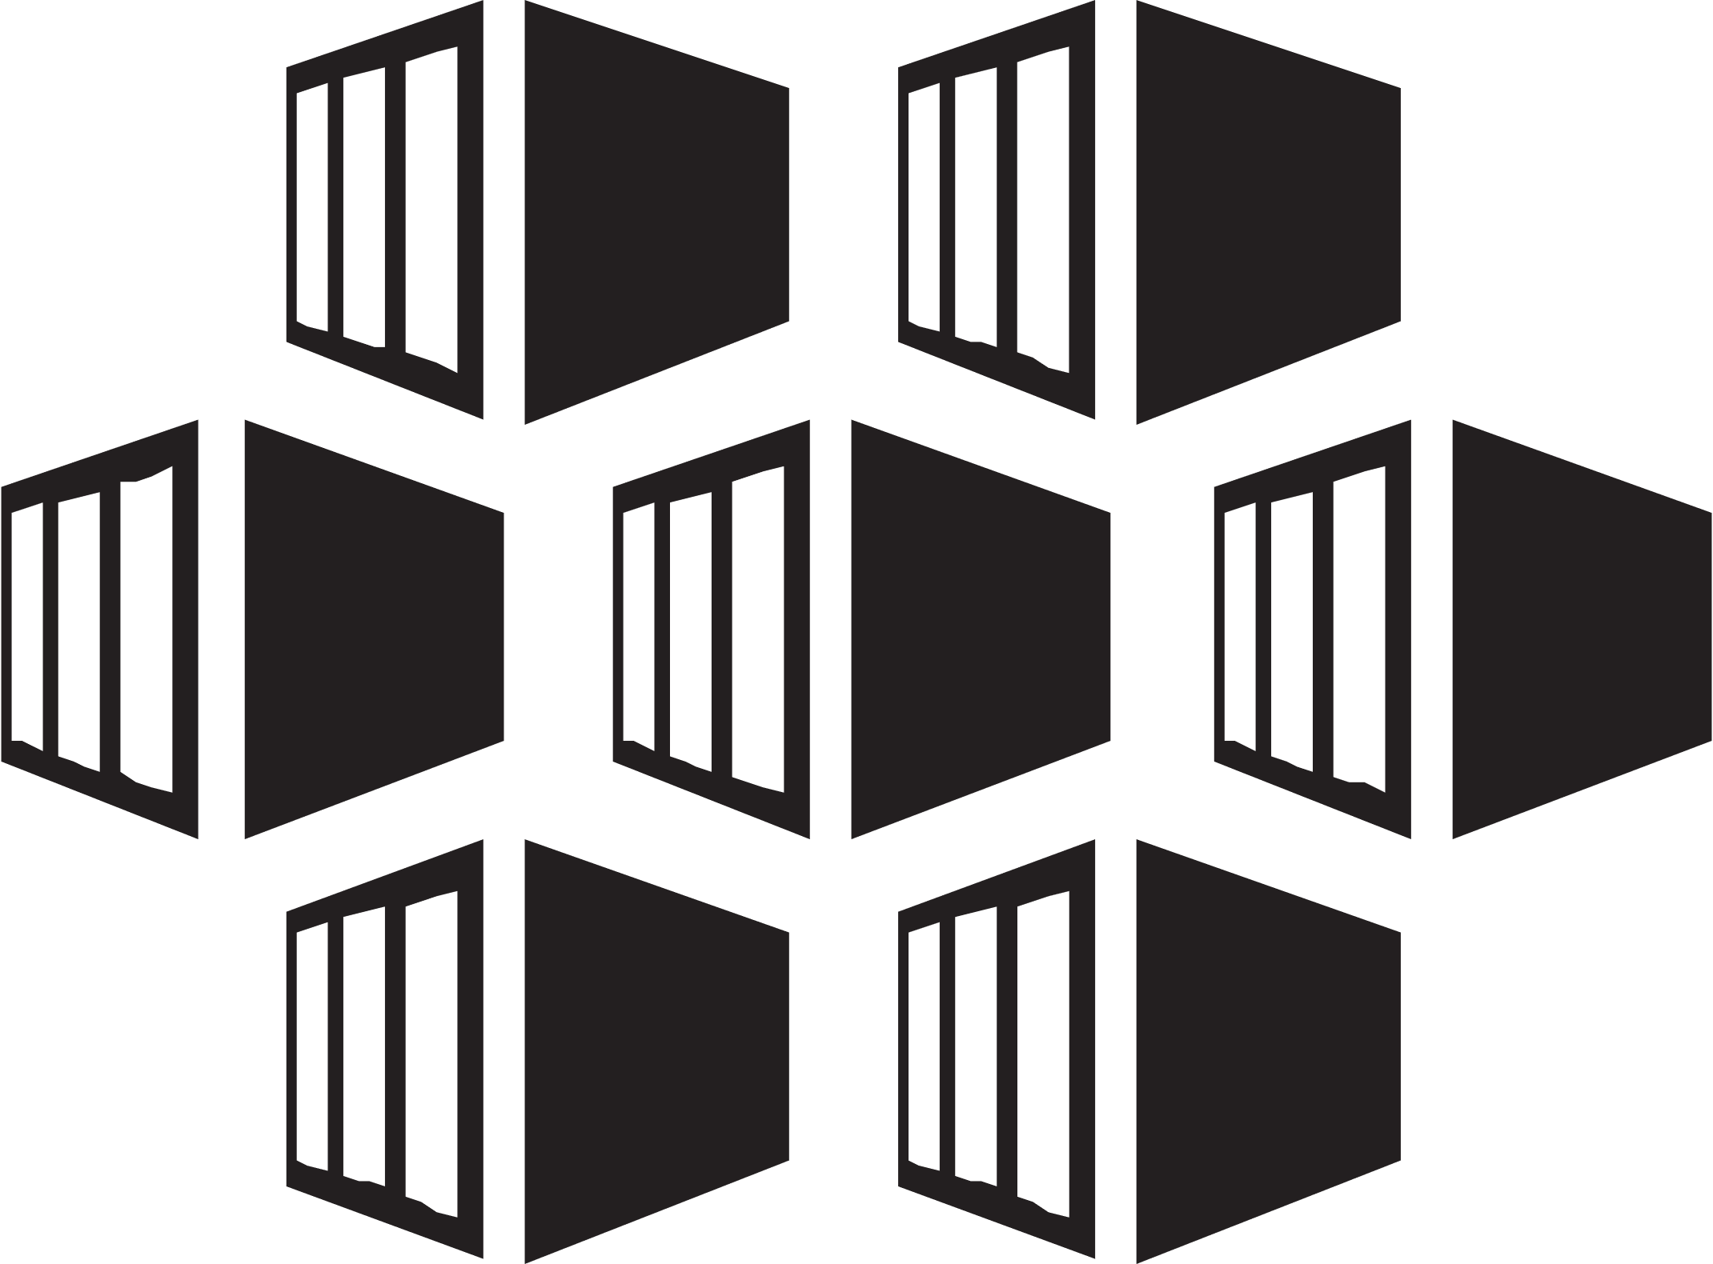
Migration strategies: Rearchitect application
What is it?
Rearchitecting is to modify or extend the existing application’s architecture/ code base, and optimize it for cloud platform and better scalability.
When to use
Application needs major revision to incorporate new capabilities or to work more effectively on a cloud platform
Leverage existing application investments
Minimize the need to manage VMs in the cloud
Meet scalability requirements in a cost-effective way
Need multiple development teams to work autonomously on application components
Looking to drive business agility with continuous innovation (DevOps)
Example
Decompose a monolithic application into microservices that work together and readily scale on Azure; rearchitect SQL Server to a fully managed Azure SQL Database.
Sample illustration
Rehost
(lift and shift)
On-premises
Azure
Application tier
Application tier
Refactor
Azure Container Service
(AKS)
Data tier
Data tier
Rearchitect
SQL Server
(on Windows Server)
Azure SQL Database
Rebuild
Notes:
Azure services
Compute: App Service, AKS, ACI, Service Fabric,
Azure Functions
Integration: API Management, Logic Apps, Event Grid and Service Bus
Data: Azure SQL Database Managed Instance, Azure Database Service for PostgreSQL, Azure Database Service for MySQL and Azure Cosmos DB
Land DevOps

Slide 20

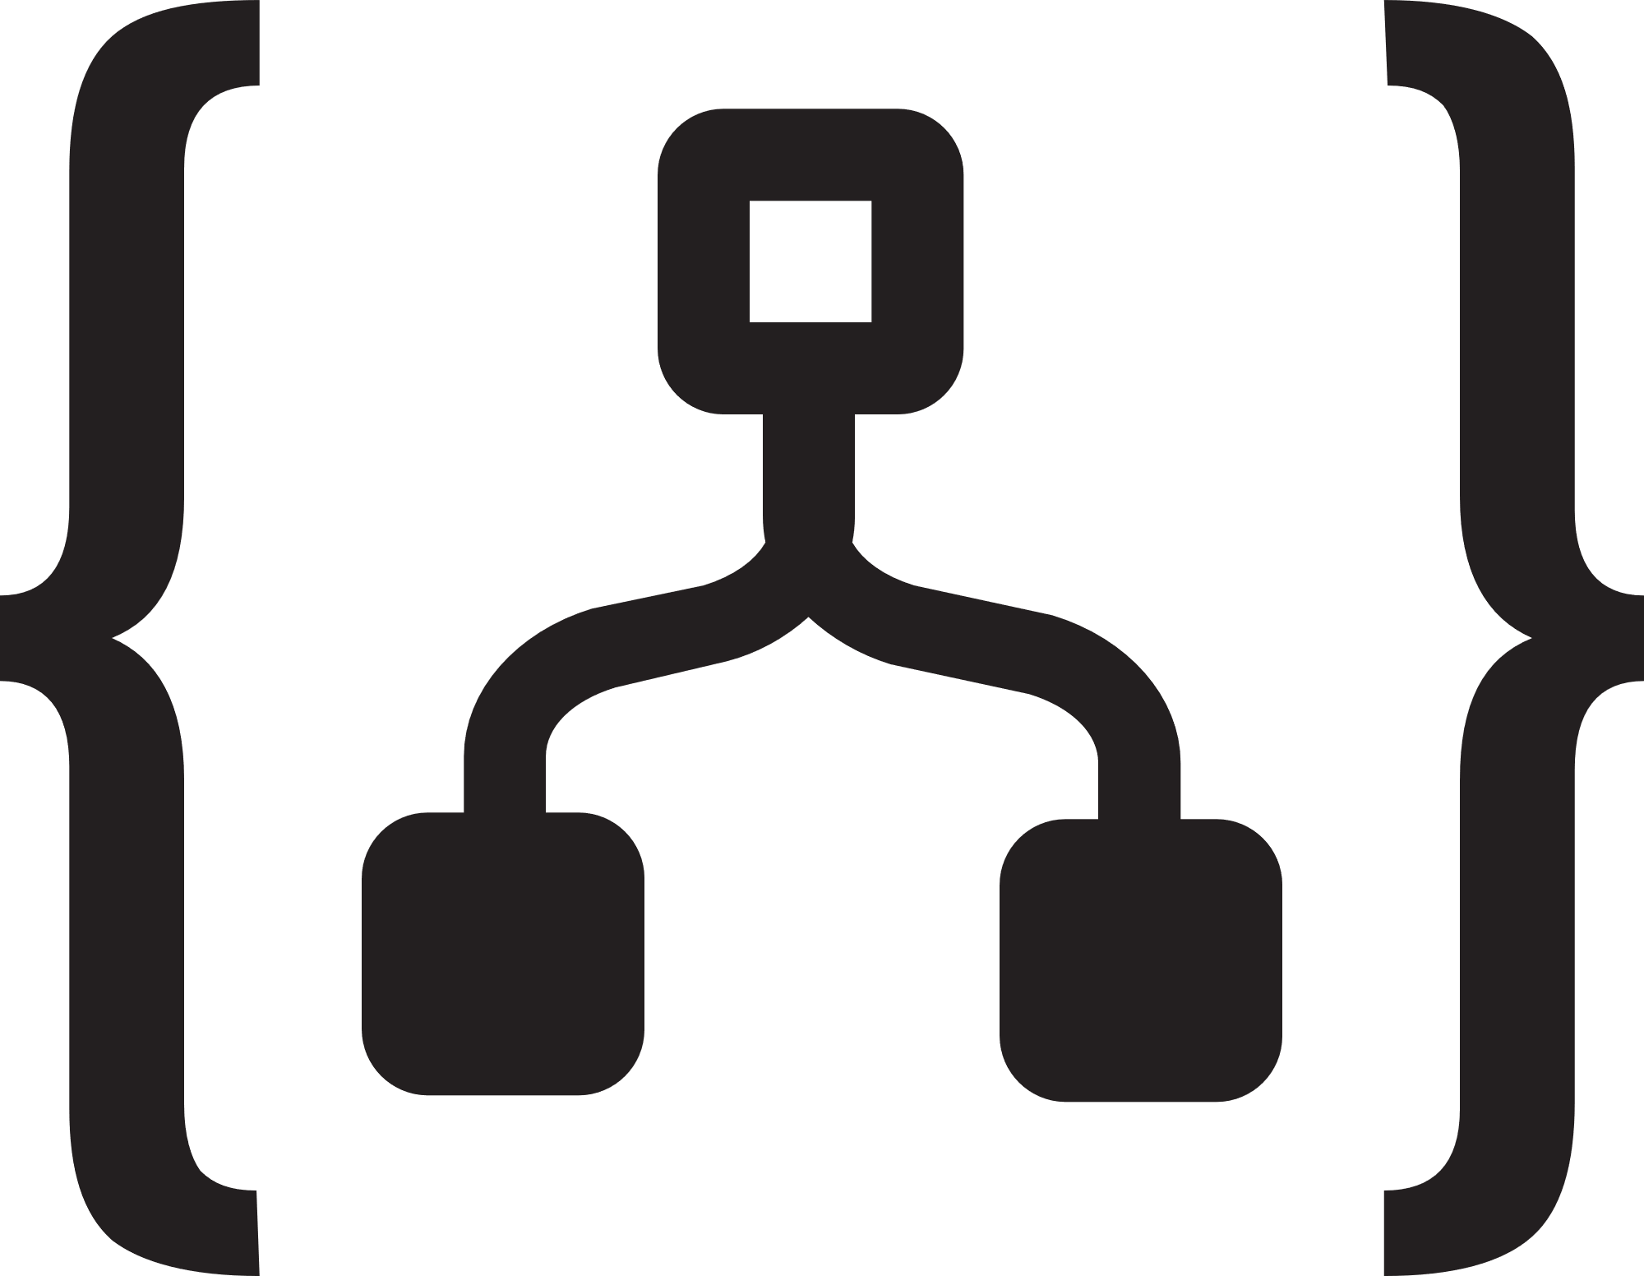

Migration strategies: Rebuild application
Sample illustration
Azure
Rehost
(lift and shift)
What is it?
Rebuild the application from scratch using cloud-native technologies on Azure PaaS
When to use
Need rapid development and the existing application is too limiting in terms of functionality and lifespan
Need to take advantage of new cloud innovation such as Serverless, Artificial Intelligence (AI), and IoT
Have the needed skills to build new cloud-native applications
Looking to drive business agility with continuous innovation (DevOps)
Example
Build greenfield applications with innovative cloud native technologies like Azure Functions, Logic Apps, Cognitive Service, Azure Cosmos DB and more
Application tier
Azure Functions
Refactor
Azure Logic Apps
Data tier
Rearchitect
Azure SQL Database
Rebuild
Azure Cosmos DB
Notes:
Azure services
Compute: App Service, AKS, ACI, Service Fabric, Azure Functions
Integration: API Management, Logic Apps, Event Grid and Service Bus
Data: Azure SQL Database Managed Instance, Azure Database Service for PostgreSQL, Azure Database Service for MySQL and Azure Cosmos DB
Land DevOps

Slide 21

Choosing modernization strategy and technology
Modernize
Objectives |  |  |  |  |  | Options to consider
 |  | Rehost | Refactor | Rearchitect | Re-build
1 | Deliver new and breakthrough capabilities faster |  |  |  |  | PaaS, Serverless
 | Optimize for developer productivity, build apps faster
2 | Provide multichannel access, including mobile and IoT |  |  |  |  | PaaS, Serverless
 | Enable wider, secure access to applications, support range of devices
3 | More easily integrate with other web and cloud apps |  |  |  |  | PaaS, Serverless
 | Leverage PaaS, increase productivity with Serverless
4 | Enable business agility with continuous innovation |  |  |  |  | PaaS, Containers
 | Increase DevOps agility across teams
5 | Meet scalability requirements of existing apps more cost effectively |  |  |  |  | PaaS, Containers
 | Optimize application architecture for cloud scale
6 | Leveraging existing investments |  |  |  |  | PaaS, Containers
 | Across dev/ops, developer experience, tooling, infrastructure and deployed apps
7 | Free up data center space quickly |  |  |  |  | IaaS
 | Free up or consolidate resources for apps that must reside on-premises
8 | Reduce capital expenditure of existing applications |  |  |  |  | IaaS
 | Switch to pay-as-you-go model, realize better budget forecasting
9 | Achieve rapid time to cloud |  |  |  |  | IaaS
 | Allow migration with minimal architectural impact
Migrate
Note: Some of the objective might apply to more than one category of applications
Notes:
Speaker note:
While this can be a lot to consumer at one glance, our guidance is, from system of record to innovation, we recommend you move up the stack, from gaining just efficiency to a true innovation play.
Each customer is a unique snowflake. We get it. We offer portfolio assessment consultation service, tools and partners to help you decide the best path forward.

Slide 22
MSIT’s own Cloud adoption approach
Roadmap planning
From…
Office servers
Portals and SPS
Any relationship mgmt
Active Source Control & WIT
Data warehouses
Industry standard verticals
From…
Office servers
Portals and SPS
Any relationship mgmt
Active Source Control & WIT
Data warehouses
Industry standard verticals
…To
Office 365
SharePoint Online
CRM Online
VSO
ADL + PowerBI
Best 3rd-party SaaS
~30%
…To
Office 365
SharePoint Online
CRM Online
VSO
ADL + PowerBI
Best 3rd-party SaaS
Retire it, right-size, eliminate environments
Retire it, right-size, eliminate environments
~15%
Use or convert to a SaaS (1st or 3rd party) solution
Use or convert to a SaaS (1st or 3rd party) solution
Expose functionality in existing SaaS/PaaS solution
Convert to Azure PaaS solution
Optimize for and move to Azure IaaS
~35%
~10%
~5%
First to move
Basic web apps
Advanced portals
Any new solutions
Any re-architected solutions
Next to move
High I/O OLTP
Regulatory and high business impact
Hard or costly to Move
HVA Systems
PKI Systems
Legacy source control
No change, lift ‘n shift to IaaS
Remain on-premise
<5%
Azure IT Roadmap
Notes:
Presentation Notes:
This slide shows the outcome of the portfolio evaluation process. It shows the output and results of portfolio evaluation, and how the vast portfolio is divided up and slated for adoption. It also shows that half of the portfolio consists of custom LOB apps.
Speaker Notes:
After analyzing our portfolio, we’ve determined rough distributions of application placement in the cloud.
As mentioned previously, this has been a great opportunity to retire applications and streamline our portfolio. We see 30 percent of our portfolio here. 1,300 apps, very aggressive about addressing capability duplication.
Retire: Evaluate whether we can retire or consolidate functionality into one app or service line.
Rightsize: IT is good at overprovisioning and underutilizing. This is reflected in utilization rates, and cold/frozen servers. Moving to the cloud is an opportunity to look at performance and capabilities of existing physical servers/VMs, and decide where to land in Azure.
Eliminate environments: Thousands of physical servers and VMs have been eliminated.
Go after cold (< 5% server utilization in 90 days) and frozen (< 20% server utilization in 7 days) assets. Get smart about how we use what we bought.
For sustain apps (no further investment), look to see if app has pre-production environments such as Dev or Test, and turn them off. This can realize a 90% cost savings.
We see 15% of our portfolio being replaced by a SaaS solution (move from Office servers to Office 365)
Adopt commodity solutions, such as Office 365, SharePoint Online, some third-party solutions, as they become available.
Transition functionality from shadow IT to retail solutions.
Complex and customized LOB applications make up 50% of our portfolio. Within that 50%:
35% have been identified as “first to move.” These are basic web apps, or re-architected solutions.
10% have been identified as “next to move.” These are being Moved to IaaS. We are more aggressive than customers, focusing on “what’s moving next?” Don’t hesitate, move apps and functionality, and make it work.
5% have been identified as “hard or costly to move.” They fail, and fail fast.
Some apps have been moved back on-premises. Why?
Azure capabilities need to develop, or need very large VM to make it work.
They can’t meet SLAs, and can’t be remediated.
Proof of concept, for example waiting for internal security reviews, due diligence, and so on.
Less than 5% of apps remain on premises.
Notes on rightsizing
Take the opportunity to rightsize as you go in. Scale up and out. Acquire technical “debt” from legacy apps, which were designed to work in on-premises environments, where latency is low.
Moving to the cloud, some considerations, such as latency, may no longer be an issue in the cloud environment. On the other hand, there may be new issues, such as the speed of light, when workloads are moved further away.
Like an onion, the center is a server. It is unlikely that an enterprise IT app is a single server. Usually multiple servers.
Move one server into public cloud? Adding 50 megaseconds can have an impact. There are upstream and downstream dependencies on service lines. For example, the store experience is an app, sales engine, and fulfillment engine. The move may affect customers, SLAs with business partners, etc.
Start with smallest computing capacity that you can make it work in; it is easier to move to larger sizes if needed.
This is a big cultural change. IT usually overprovisions computing capacity.
You must continue to monitor environments. For example, if writing an app for PaaS, it doesn’t automatically rightsize itself.
Process for approaching complex/customized LOB apps
Expose functionality in existing SaaS/PaaS solution. May have to re-architect or rebuild.
Convert to Azure PaaS solution.
Optimize and perform bulk operation, move to Azure IaaS VM.
No change, lift and shift to IaaS. Move the existing IT footprint to Azure. Re-create/copy to Azure, or move from on- to off-premises.

Slide 23
Assessing your App Portfolio
Packaged LOB Apps
e.g. SAP, Microsoft Dynamics..
Custom Internal LOB Apps
e.g. payroll system
Custom External facing Apps
e.g. company website
New AI /Intelligent Apps
e.g. real-time bot messaging
App characteristics to consider when determining approach
Core Transactional vs. Differentiated or Innovative
Life Cycle of App
Regulatory, Compliance and other requirements..
Complexity of App
Architecture of existing apps

Slide 24
Azure. Cloud for all.
Productive
Hybrid
Intelligent
Trusted
Notes:
Azure. Cloud for all.
These 4 pillars represent the main value proposition for what differentiates Azure from the competition.
As you can see in the proof points, these are the reason why customers choose Microsoft, because of the unique value that we provide in a productive, hybrid, intelligent, and trusted cloud.
With Azure, you can do—or be—all of these things.
Productive
Get unparalleled developer productivity with integrated tools from mobile DevOps to serverless computing.
Learn about accelerating innovation
Hybrid
Develop and deploy where you want, with the only consistent hybrid cloud on the market. Extend Azure on-premises with Azure Stack.
Learn about our consistent hybrid cloud
Intelligent
Create intelligent apps that delight with data-driven experiences. Go quickly from concept to release with Azure data services and artificial intelligence, from image recognition to bot services.
Learn about intelligent apps
Trusted
Join startups, governments, and 90 percent of Fortune 500s that trust the Microsoft Cloud for security, privacy, transparency, and the most compliance coverage of any cloud provider.

Slide 25
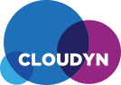










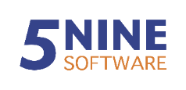
Current Tooling Landscape
Discover
Migrate
Optimize
Microsoft
Azure Migrate
Database Migration
Assistant
Microsoft Assessment & Planning Toolkit
Azure Site
Recovery
Database Migration
Service
Operations
Management Suite
Partners
https://azure.microsoft.com/en-us/services/azure-migrate/
https://azure.microsoft.com/en-us/migration/assess/#microsoft-tools

Slide 26


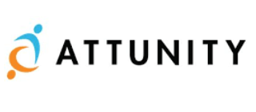
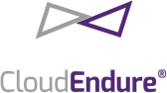


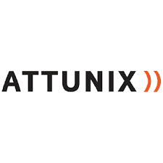









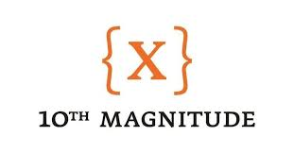

2. Technical Perspective: Assessment of Current Situation
Set
Expectations
1
Collect the inventory of
Applications
Infrastructure
Data
Dependencies
2
Select Right Partner
3
Assess and Evaluate
Capabilities
Delivery Time
Cost
Migration Support Potential
Translate Inventory to Azure
Create early business case
Prepare for TCO/ROI
https://azure.microsoft.com/en-us/migration/partners/

Slide 27
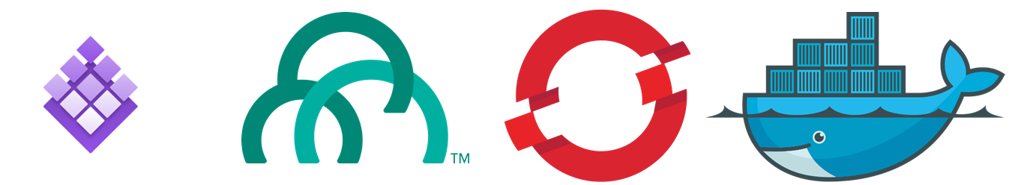
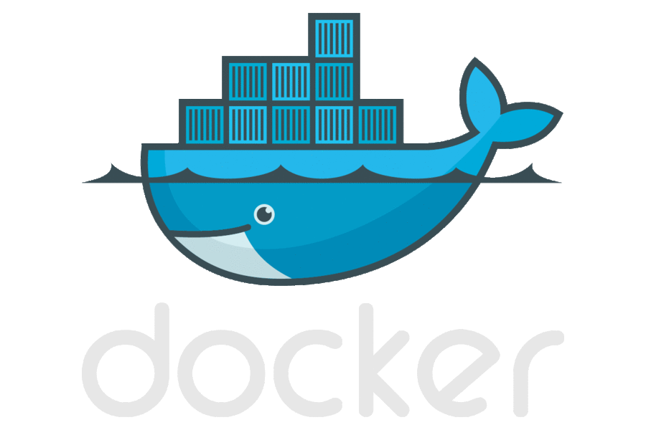
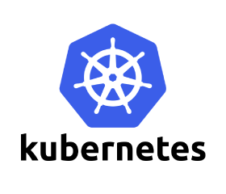
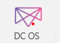
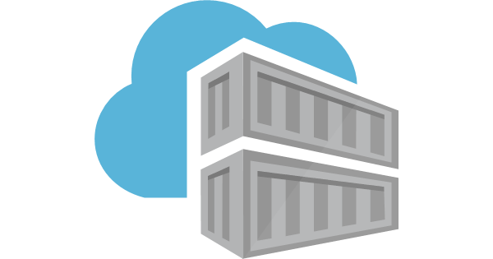




Providing choice to Customers
Options of compute
Leverage the Azure platform designed for your application needs
Keep using the platform of your choice, running great on Azure
PaaS Services & Serverless
Azure App Service
Redhat Openshift Container Platform
Pivotal Cloud Foundry
Functions
managed container orchestrators
Service Fabric
Azure Container Service (AKS)
Docker Swarm
Kubernetes
DIY with raw compute
Windows VMs
Linux VMs
Secure image
management
Azure Container Registry
Docker Hub, private registry
Choice of developer
tools & clients
Visual Studio tools
InteliJ
Ma en
Jenkins
Notes:
Containers are becoming the common currency of deployment and have fundamentally changed the way developers develop their applications, the way applications are deployed, and the way system administrators manage their environments.
Containers offer a broadly accepted and open standard, enabling simple portability between platforms and even between clouds.
Azure offer you the flexibility to use tools that your teams are familiar with. You can use Azure Container Registry to store and manage container images across all types of Azure deployments and deploy them using compute option that works best for your needs.
If you’re getting started with containers, Azure Container Instances (ACI) provide a simple experience to get started with containers in the cloud, enabling you to quickly create and deploy new containers with only a few simple parameters. For web apps, we now support containers in App Service which offers built-in CI/CD and a fully managed platform to run container based web applications.
For advanced applications, you would typically need a product that supports container orchestration. We support all the leading container & orchestrators we have in the marketplace.
Azure Service Fabric is one such platform we also use to run many of our own services such as Skype for Business, Dynamics 365. It supports container orchestration, both for Windows and Linux, and can be used to run large scale applications.
One of our core tenets is to provide to provide choice and Microsoft was one of the first to support the leading open source container orchestrators, including Kubernetes, Docker Swarm, and DC/OS, in the cloud.

Slide 28
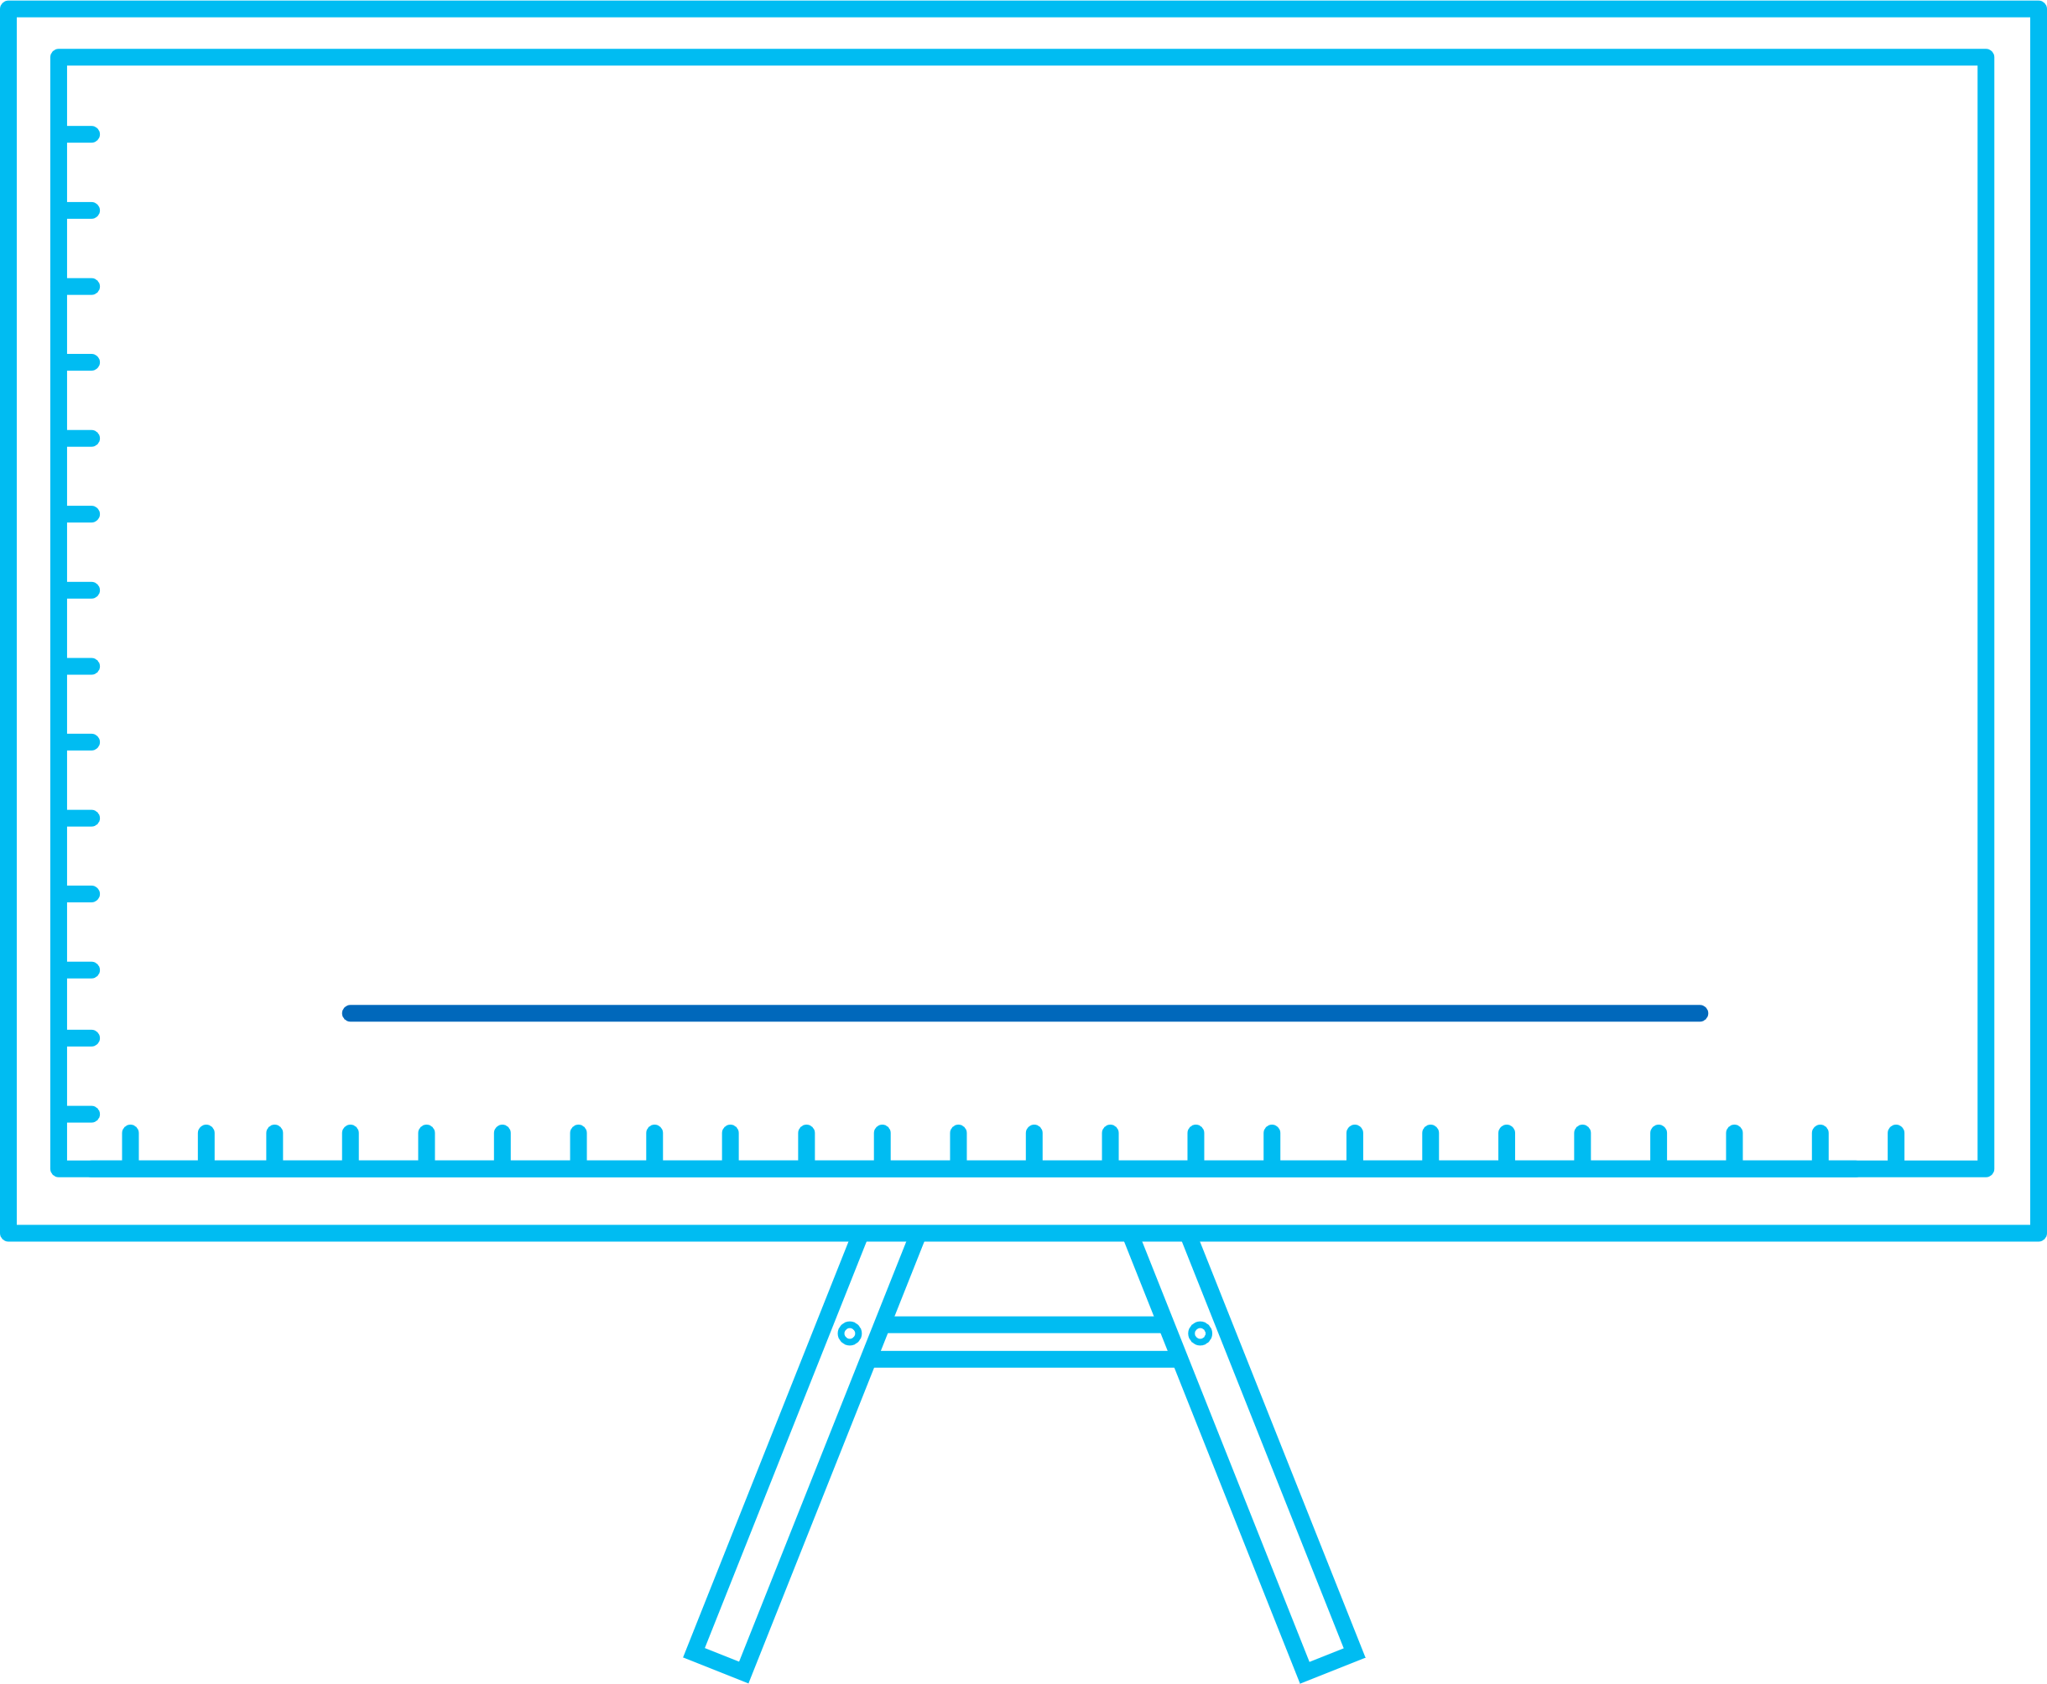



The more you modernize, the lower your operational costs
$$$
On-premises
Use a Azure Migrate and TCO analysis to better understand what gains can be achieved by moving to Azure
$$
IaaS
PaaS
PaaS
15-20% savings over on-premises*
35% over on-premises, 15% over VMs*
$
*Based on assumptions using the Azure Cost Calculator
Notes:
By modernizing the infrastructure that powers your applications, you can drive significant cost efficiencies and save on IT maintenance budget.
Not only that, there is a McKinsey study which says “by digitizing information-intensive processes, costs can be cut by up to 90 percent and turnaround times improved by several orders of magnitude”
The second is from a MIT study that found agile firms increase revenues 37 percent faster than non-agile companies; the same businesses also generate 30 percent higher profits than their non-agile counterparts.
The third one is my favorite as when I talk to customers about cloud they typically ask whether it will make their data more secure? And we had comScore run a study for us and it found 94% on-premises customers experienced additional security benefits. Which is not surprising because once you move your servers say SQL server to the cloud, we will keep them up-to-date and monitor the security.
Here is an example for
On-prem - Cut traditional infrastructure expenses, including power and required floorspace
IaaS – Reduce datacenter, IT resource, and outsourcing costs
PaaS – Use a free cloud migration assessment and TCO analysis to better understand what gains can be achieved by moving to Azure
Assumptions:
On prem:
2 x servers + storage, ~75k each
Licensing/Support/admin costs ~20k annual
3-5 year lifespan ~ 155k total
Approx. $4000/mo over 4years.
Using VMS,
VMs: 2 x D12: 4 cores, 28 GB RAM, 200 GB disk
Managed disks: 4x S30 - 1024 GB
2x the infrastructure for a bare-minimum HA solution
$3284/mo
Azure SQL DB Elastic Pool:
Standard tier, 1200 eDTUs level, 1200 GB storage (max 500 DBs)
Storage 1200 GB
$2697/mo
Single Database:
10 x Standard tier, S3 level, 100 DTUs, 250 GB storage per DB
$1500/mo

Slide 29
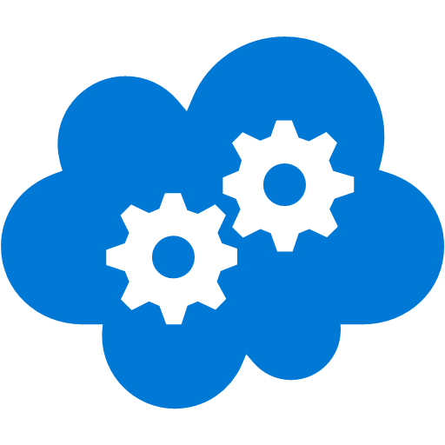
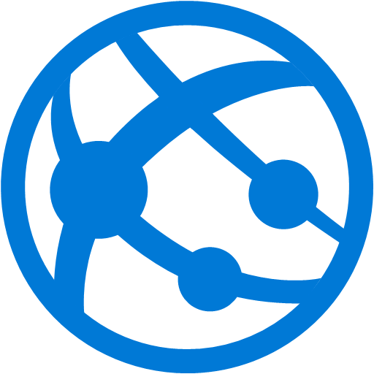




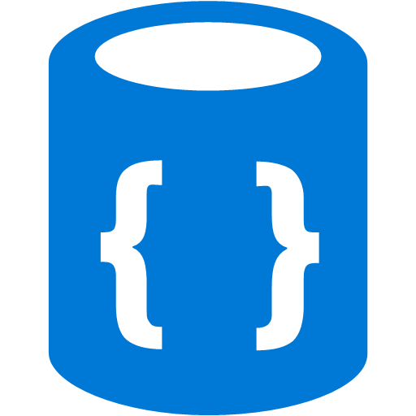
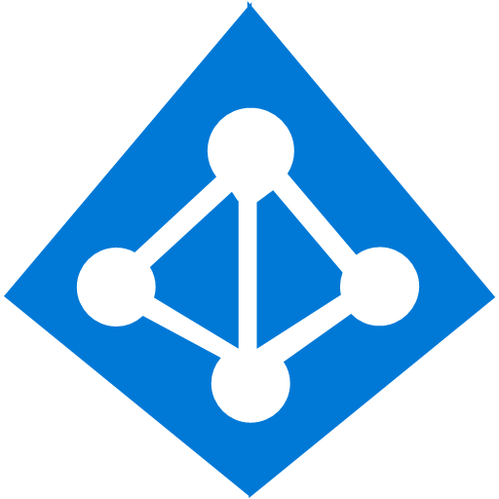






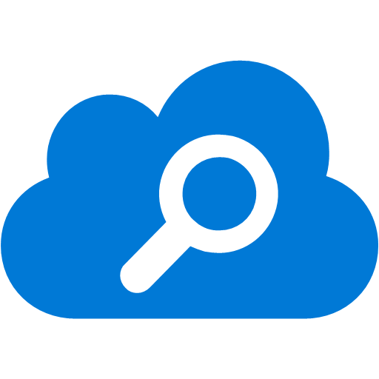





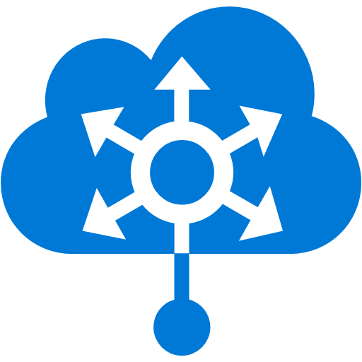
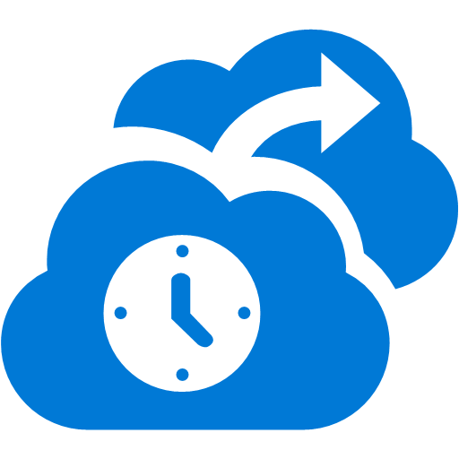





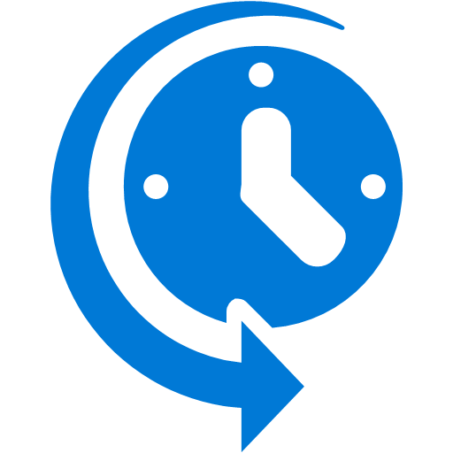
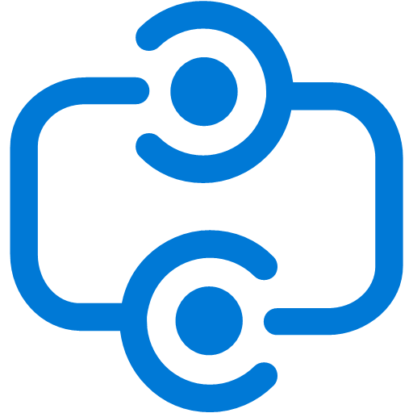


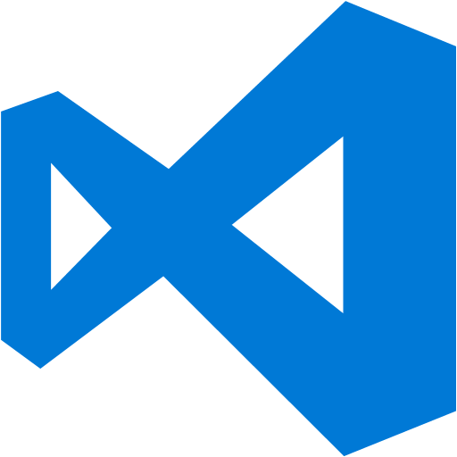


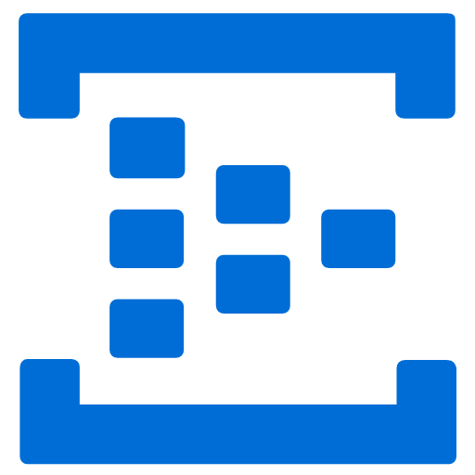
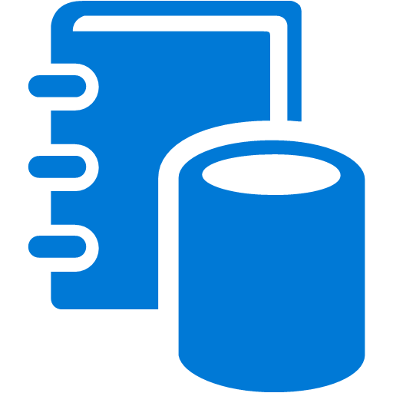


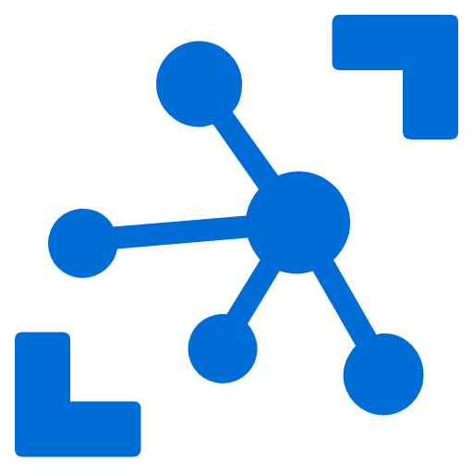





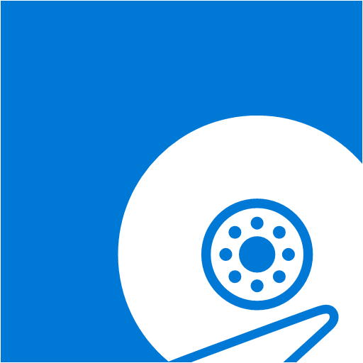






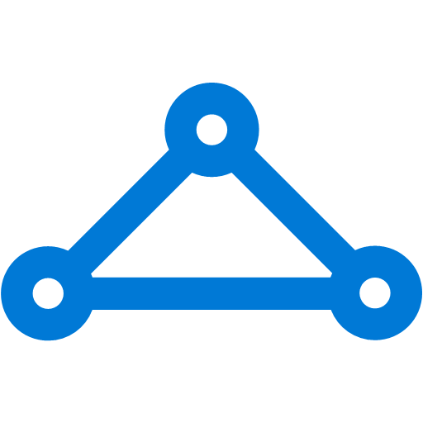


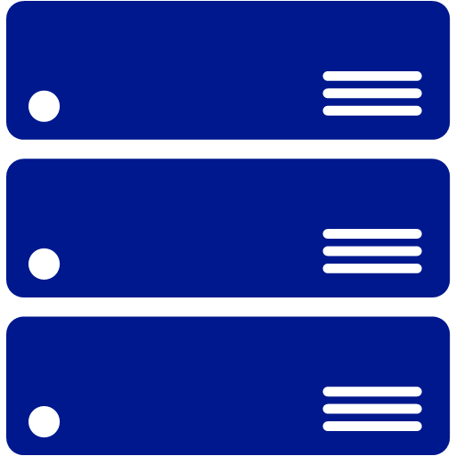
Platform Services
Security & Management
Services Compute
Web and Mobile
Data
Hybrid
Operations
Cloud
Services
Service
Fabric
Web Apps
API Apps
Portal
SQL
Database
Data
Warehouse
DocumentDB
Azure AD
Health Monitoring
Azure Active
Directory
Batch
RemoteApp
AD Privileged
Identity
Management
Mobile
Apps
Logic Apps
Redis
Cache
Azure
Search
Storage
Tables
Azure AD
B2C
Integration
Domain Services
Multi-Factor
Authentication
API
Management
Notification
Hubs
Storage
Queues
BizTalk
Services
Analytics & IoT
Backup
Automation
Hybrid
Connections
Service Bus
Developer Services
HDInsight
Machine
Learning
Stream
Analytics
Data
Lake
Operational
Analytics
Scheduler
Key Vault
Visual Studio
Azure
SDK
Data
Factory
Event
Hubs
Data
Catalog
Import/Export
Media & CDN
Store/
Marketplace
Media Services
Content Delivery
Network (CDN)
VS Online
App
Insights
Mobile
Engagement
Azure Site
Recovery
IoT Hub
VM Image Gallery
& VM Depot
StorSimple
Infrastructure Services
OS/Server Compute
Storage
Networking
Virtual Machines
Container
Service
BLOB Storage
Azure
Files
Premium
Storage
Virtual Network
Load Balancer
DNS
Express
Route
Traffic Manager
VPN Gateway
App
Gateway
Datacenter Infrastructure (34+ Regions, 24 Online)
Notes:
Why this Slide:
It shows we have a very broad platform. It about BOTH IaaS and PaaS, that these work together. It shows that we continue to lead in world class IT capabilities and that there’s really nothing missing.
Key Points:
We have already seen how the Azure Platform is IaaS + Pass – but I want you to understand that this is a huge number of capabilities – IT building blocks if you will.
Every one of these blocks you provision anytime, self-service anywhere in the world 24x7. You pay for what you use, you can get more or less anytime and you can fully automate everything…
DON’T spent too much time on this slide – you are going to DEMO (aren’t you!!!)… DON’T go through each block…
Transition to NEXT Slide: Make the build go backwards to show JUST IaaS and then you will go to the demo to show it.

Slide 30
Azure App Service

Slide 31
Azure App Service
Quickly build, deploy and scale powerful cloud applications without worrying about infrastructure
✓
High productivity
Fully managed
Enterprise grade
Accelerate development using existing language skills, familiar frameworks, built-in CI/CD, and intelligent diagnostic capabilities
Focus on application logic and let Azure take care of mundane tasks like capacity provisioning, OS patching, scaling, load balancing and domain management
Meet rigorous performance, security and compliance requirements through a choice of hosting options, robust regulation support and MSI integration

Slide 32
Azure App Service
Quickly build, deploy and scale powerful cloud applications without worrying about infrastructure
High productivity
.NET, Node, Java, Docker, PHP, Ruby, Python
Staging & deployment
Testing in production
App gallery marketplace
Fully managed
Auto scale & load balancing
High availability w/ auto patching
Reduced operations costs
Backup & recovery
Enterprise grade
Global data center footprint
Hybrid support
AAD integration
Secure & compliance

Slide 33
Migration Resources
Assessment for migration to App Service:
https://www.movemetothecloud.net/
https://aka.ms/appmigrate
Assessment for migration to SQL Azure PaaS:
https://blogs.msdn.microsoft.com/datamigration/2017/03/10/released-data-migration-assistant-dma-v3-1/

Slide 34
Next Steps
Assessment of customers application strategy
Other workloads which we can choose to move to cloud
http://aka.ms/ceplays

Slide 35
Questions?

Slide 36
Thank you!

